Slide 1
What is Git?
Lesson 2

Slide 2
Basic Commands
Mastering a Basic Workflow

Slide 3
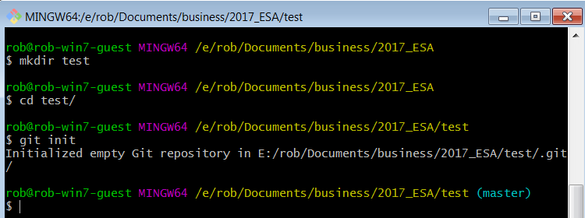
git init – Initialize an Empty Repo

Slide 4
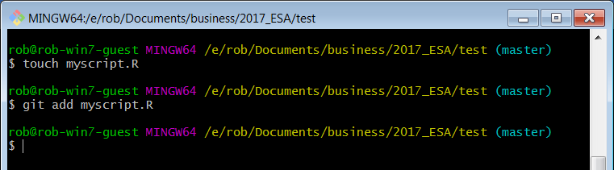
git add – Add a Document to the Staging Area

Slide 5
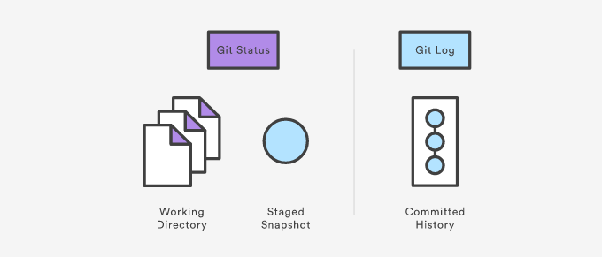
Viewing the Repo

Slide 6
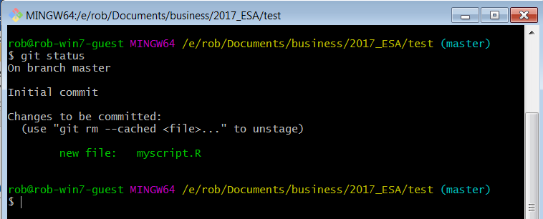
git status – What’s Happening?

Slide 7
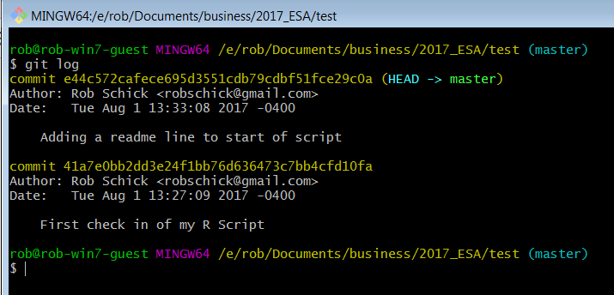
git log – How do we View the History?

Slide 8
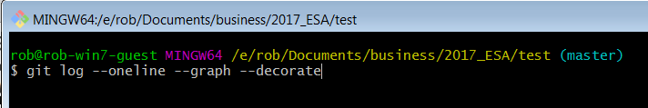
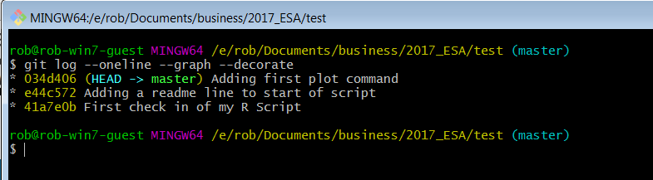
git log – With Options

Slide 9
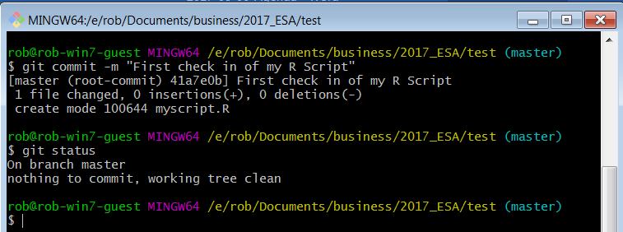
git commit – Check Files into the Repo
git commit -m "First check in of my R Script"

Slide 10
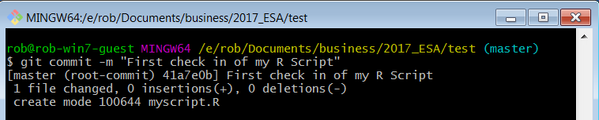
Ok, What Just happened?
sha-1 commit
What’s Changed

Slide 11
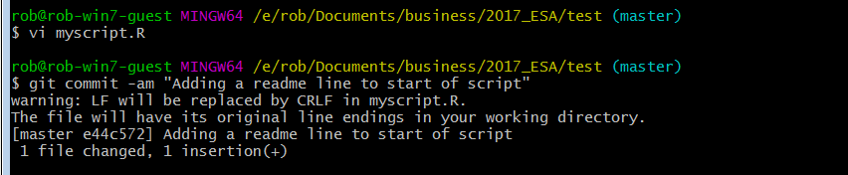
Lather, Rinse, Repeat
What’s Changed
sha-1 commit

Slide 12
Good Commit Messages*
Be concise, yet evocative. At a glance, you should be able to see what a commit does. But there should be enough detail so you can remember (and understand) what was done
Describe the why, not the what. Since you can always retrieve the diff associated with the commit, the message doesn’t need to say exactly what changed. Instead it should provide a high-level summary that focuses on the reasons for the change

Slide 13
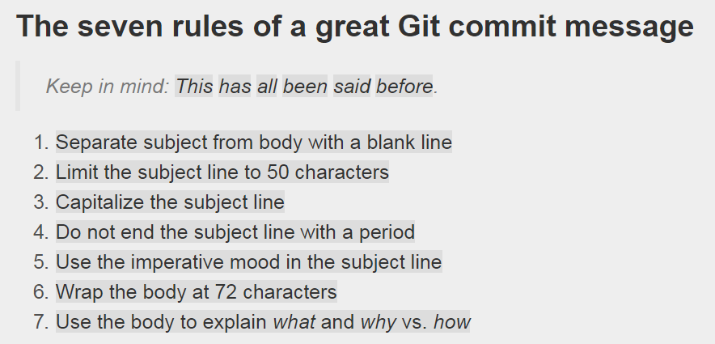
Good Commit Messages

Slide 14
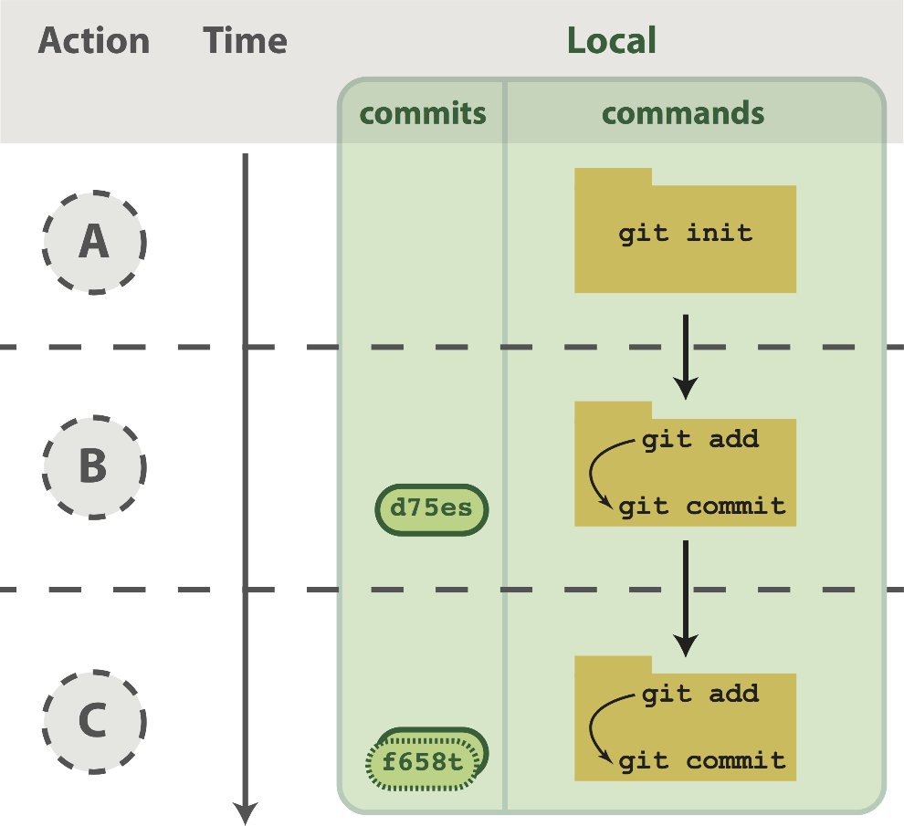
Workflow Visualized

Slide 15
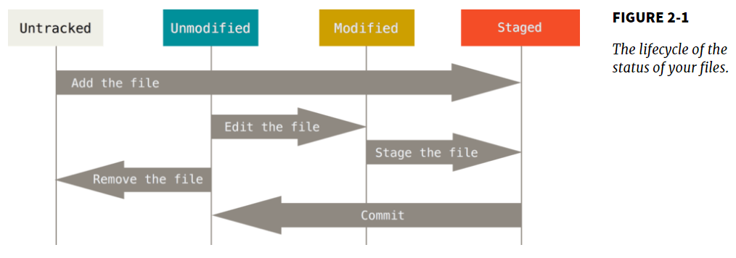
Workflow Visualized

Slide 16
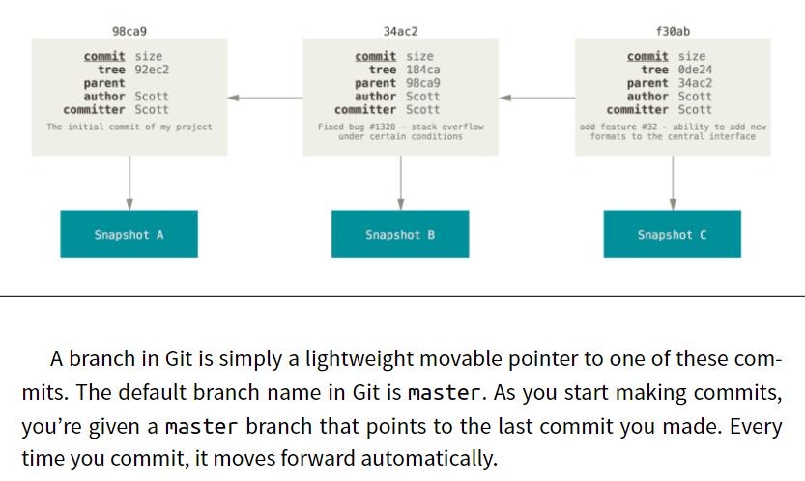
Commit Graph Visualized

Slide 17
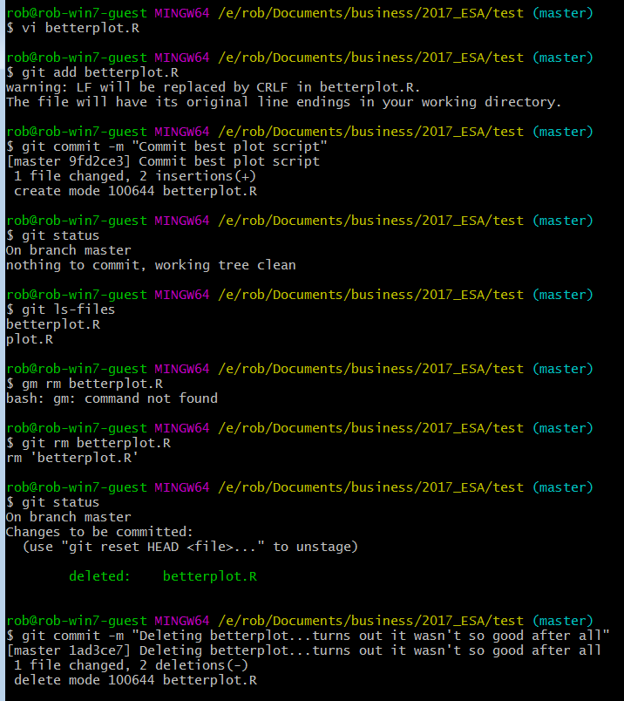
git rm & mv
Don’t delete or rename tracked files with the OS; use:
git rm

Slide 18
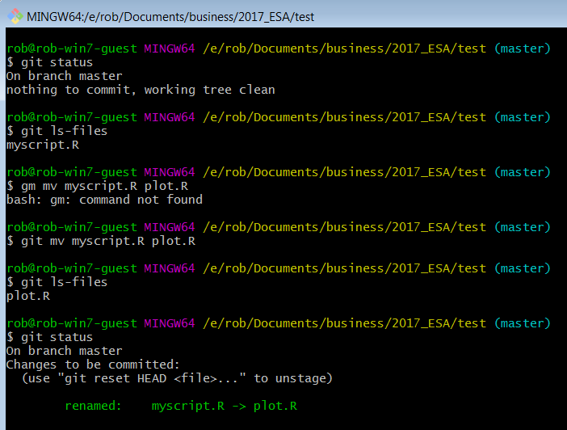
Git rm & mv
Don’t delete or rename tracked files with the OS; use:
git rm
git mv

Slide 19
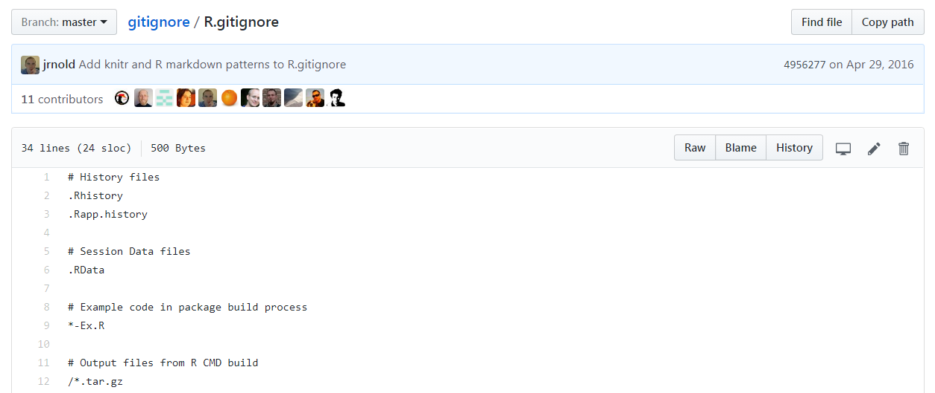
.gitignore

Slide 20
.gitignore
Make the code produce a plot file, say a pdf
Run the code
Make a .gitgnore file
.pdf
.Rout
Add & commit the .gitignore
Run ls (you should see the pdf and the Rout file)
Run git ls-files (you should not see the pdf and the Rout file)

Slide 21
Break Time?

Slide 22
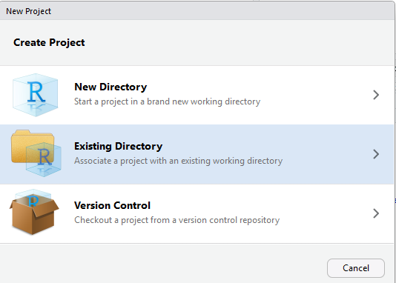
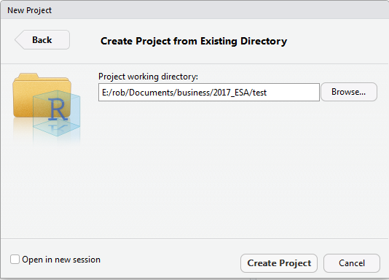
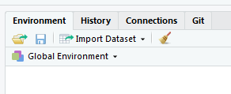
New R Project With Your Existing Repo

Slide 23
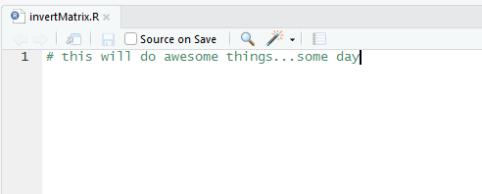
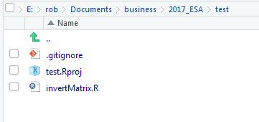
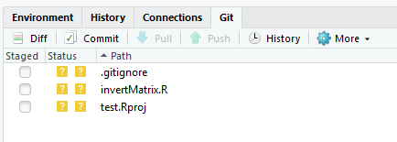
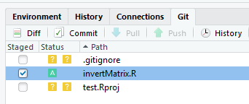
Make the Changes in RStudio
push/pull greyed out
Add invertMatrix.R

Slide 24
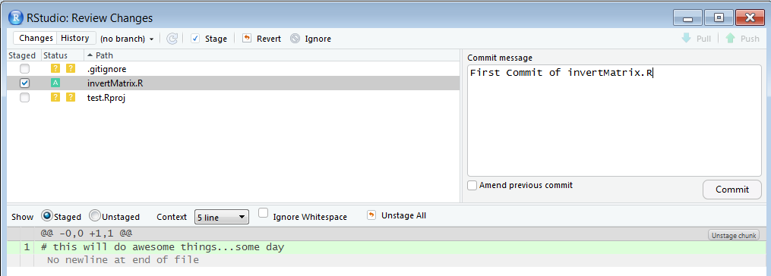
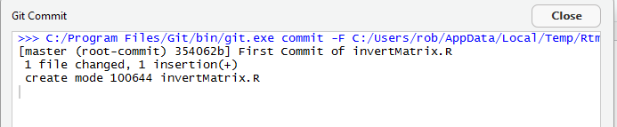
Commit the Changeset

Slide 25
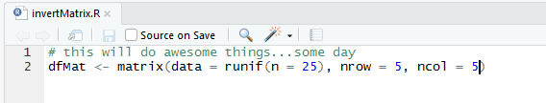
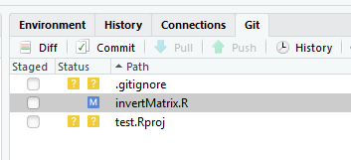
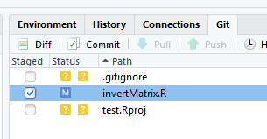
Make Some Modifications
invertMatrix.R
has been
modified
invertMatrix.R
has been
added

Slide 26
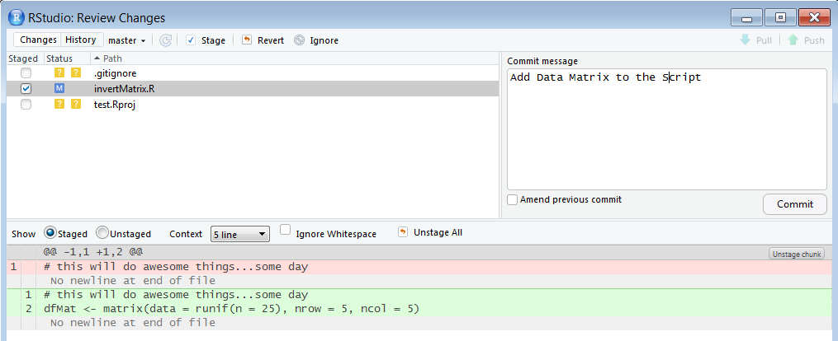
Commit the Modifications

Slide 27
Git in RStudio Covers Most of Your Needs
If RStudio does all of this, why bother with the command line?
Most of the time you won’t need to, but when you need it, you need it
Merge conflicts, for example

Slide 28
Code Time – II
See Lesson2.pdf again

Slide 29
Connecting a Local Repo to a Remote Repo

Slide 30
Git is a Distributed Version Control System
Peer-to-peer as opposed to server-client
Common operations (commits, viewing history, etc.) are fast since there is no need to communicate with a central server
Communication is only necessary with sharing changes among peers
Each working copy effectively functions as a remote backup of a codebase and its change history – protecting against data loss

Slide 31
How Does My Local Repo Sync with GitHub*
Several ways to do this:
Clone an existing repository from GitHub to a local folder
Your own, or
Another coder’s
Initialize a repository locally and push to GitHub
Start a new project in RStudio with version control

Slide 32
Local First
We’ve started this with git init in a local repo
How connect to GitHub?
Make an empty repo on GitHub, i.e. no README
Copy the url of this repo from GitHub
Navigate to your current folder
Add the remote
Push the repo

Slide 33
GitHub First
You did a version of this when you worked through the Happy Git with R install tutorial
How connect to GitHub?
Make a repo on GitHub (I typically add both a README and a .gitignore file)
Copy the url of this repo from GitHub
Navigate to your current folder
Clone the repo

Slide 34
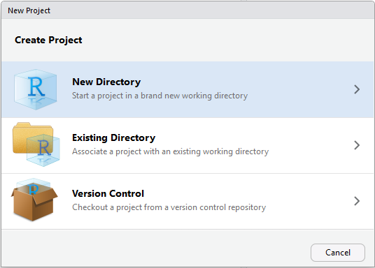
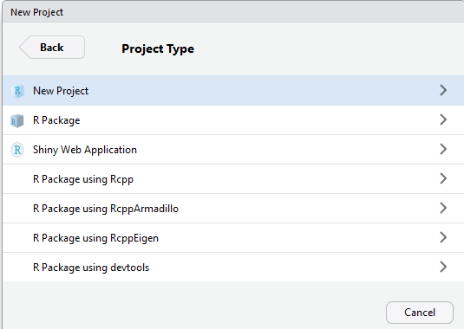
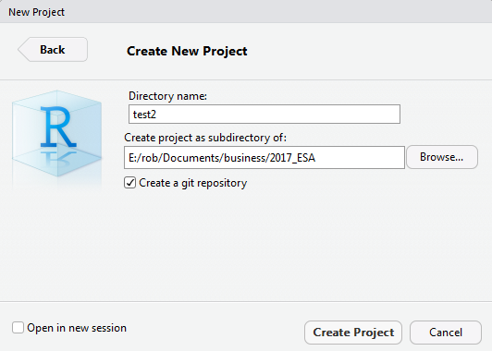
From RStudio*
Make a new project
Project type
Choose name & git

Slide 35
My Preferred Way
Start on GitHub
Create an empty repo
Include a README file
Include a .gitignore file
Clone it locally on the command line
Set up a new project in RStudio in the existing directory

Slide 36
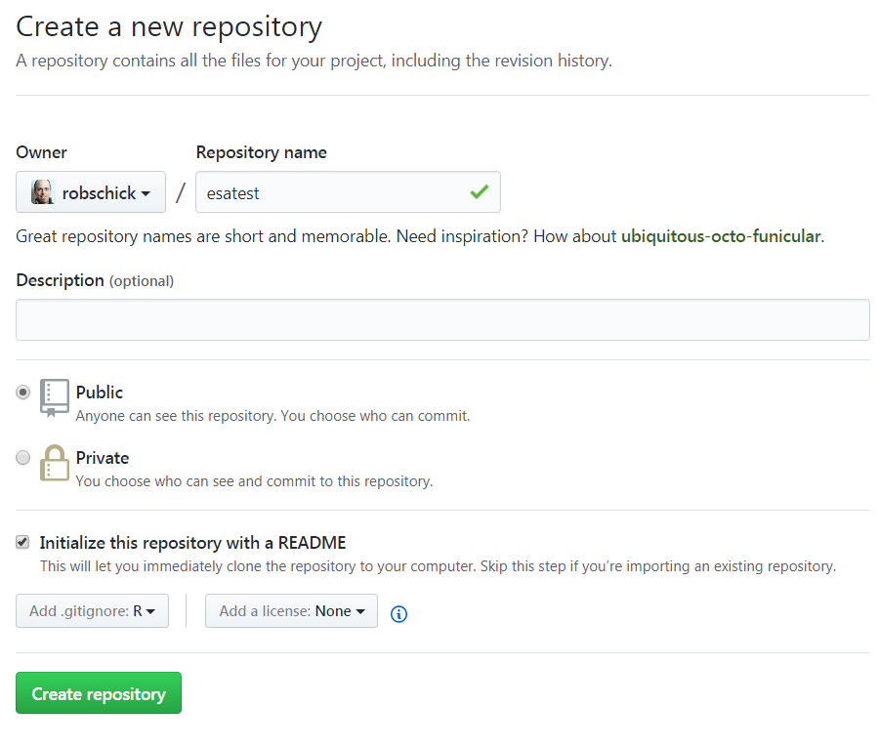
Let’s Practice

Slide 37
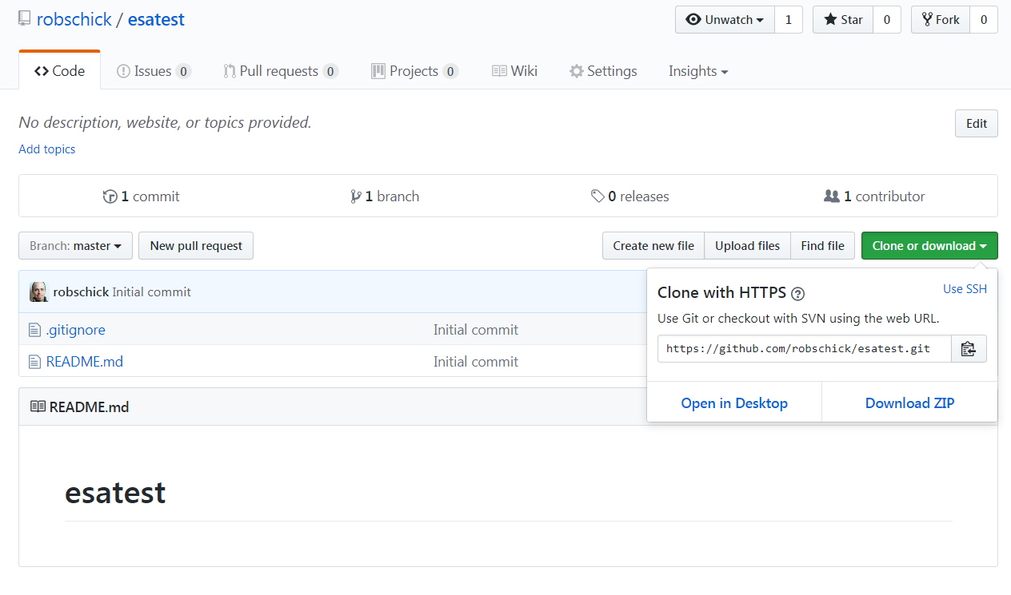
Let’s Practice

Slide 38

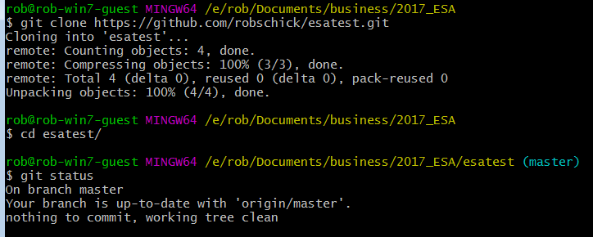
Let’s Practice

Slide 39
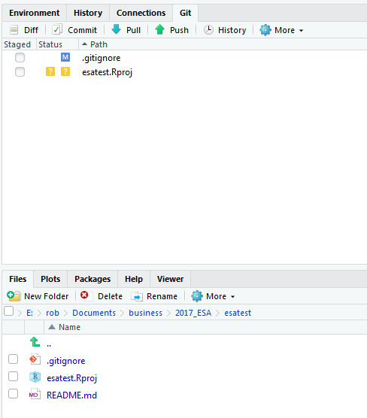
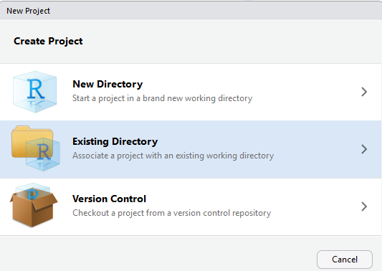
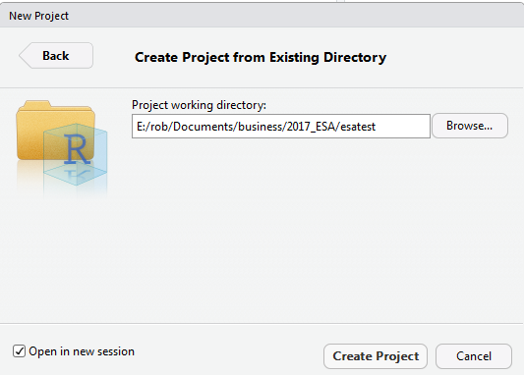
Let’s Practice

Slide 40
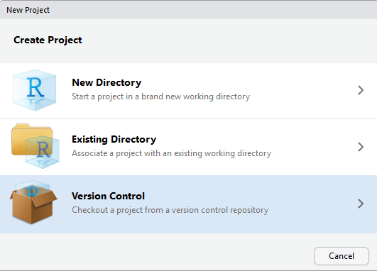
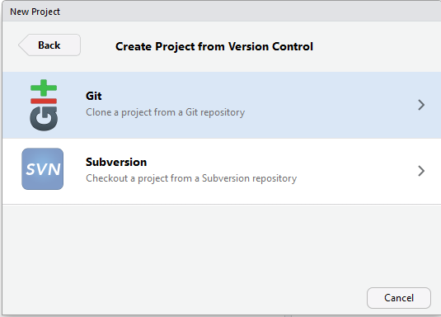
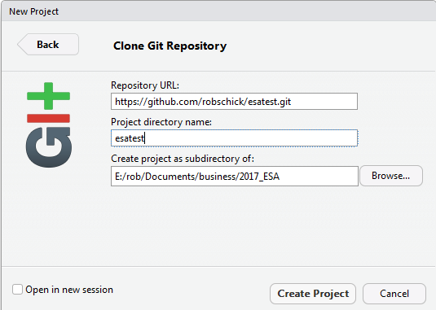
Bypass the Command Line

Slide 41
Pushing to GitHub – How Often?
Several schools of thought on how often to push
A prominent one (Hadley Wickham) is to push considerably less often than you commit*
“Pushing code means publishing code”
“Strive to push code that works”
I tend to push more often than this, because I code on small teams, and I like the back up

Slide 42
Pushing to GitHub – Good Commit Messages*
Be concise, yet evocative. At a glance, you should be able to see what a commit does. But there should be enough detail so you can remember (and understand) what was done
Describe the why, not the what. Since you can always retrieve the diff associated with the commit, the message doesn’t need to say exactly what changed. Instead it should provide a high-level summary that focuses on the reasons for the change

Slide 43
Practice a Cycle in Local Repo

Slide 44
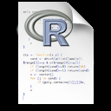
Three Local States with Remote
Working Directory
Staging Area
Repository (.git folder)
Remote (GitHub)
git push

Slide 45
Adding GitHub to the Workflow – git push

Slide 46
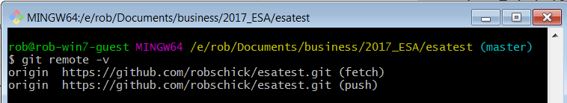
Knowing Your Remotes

Slide 47
What is a Merge Conflict?
A merge operation in git is when you try to blend changes made:
To the same file
On two different branches
Wait, but we haven’t talked (much) about branches?
For now, know that we’ve been working with one branch – MASTER
So we can work with the same branch – MASTER – in two (or more repos):
Local
GitHub
Node
And these can come into conflict – let’s try!

Slide 48
Merge Conflicts
Make sure your working directory shows a clean status
Do a git pull
Do a git push
Modify the file locally
Commit it, but don’t push it yet
Navigate to the repo on GitHub
Modify the same file on GitHub
Commit it
Go back to local repo and attempt a push

Slide 49
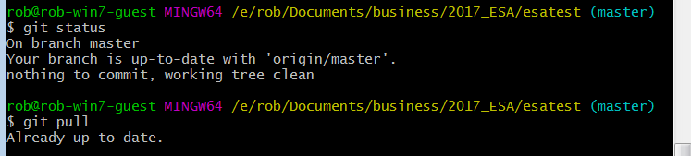
Check Status of Your Local Repo
Best practice to pull before you push (n.b. if it’s just you and GitHub, this isn’t as big a concern)

Slide 50
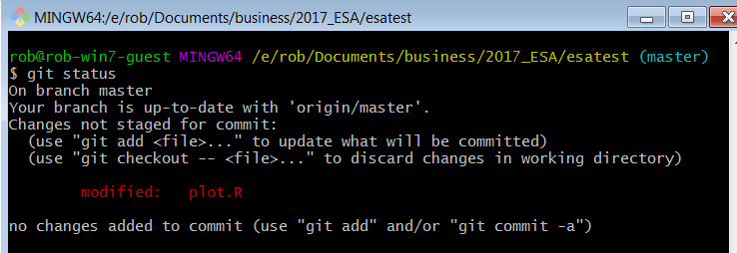
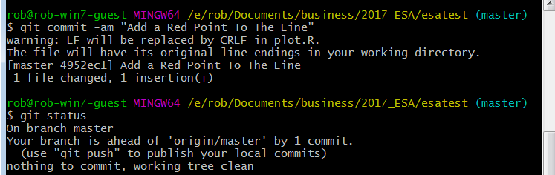
Make Local Changes

Slide 51
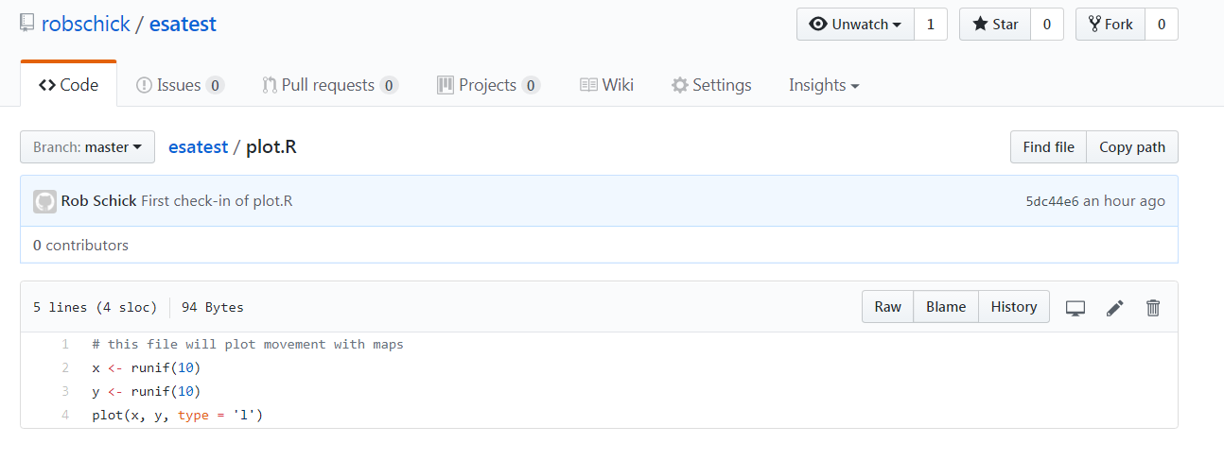
Make Remote Changes
Edit on GitHub

Slide 52
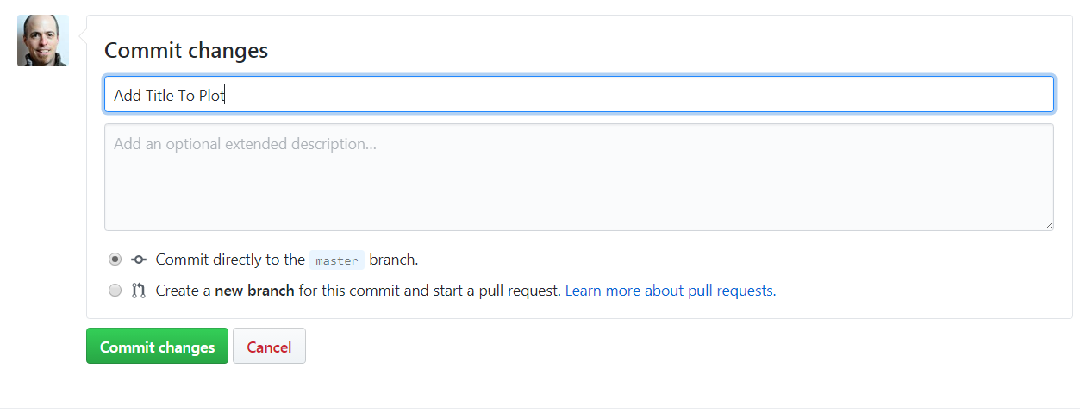
Commit the Changes

Slide 53
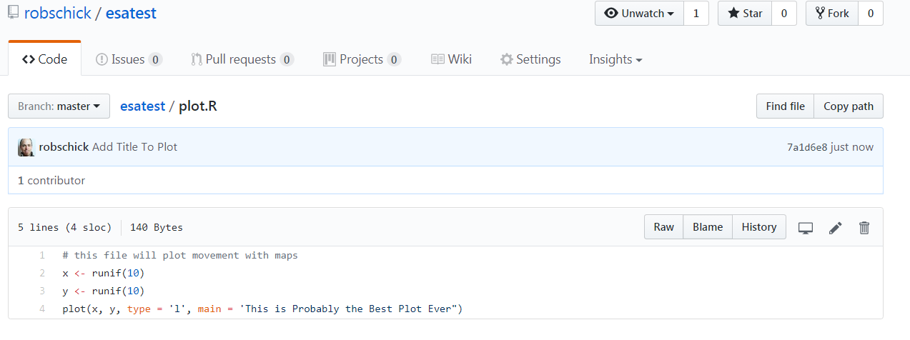
View Status on GitHub

Slide 54


What’s Happened
We have one repo – esatest (or whatever you’ve named it)
We’ve made and committed changes in two different places
Now let’s try to sync the repos by pushing our local to GitHub

Slide 55

Pull the Changes

Slide 56

Check Status

Slide 57

View the Conflict
Unchanged lines
Incoming marker
Branch Separator
Current marker
sha-1 from GitHub

Slide 58
Manually Resolve the Conflict
Choose this Block
Or this Block

Slide 59

Add it, Commit it, Push it
Note status
Merge Resolved

Slide 60

Merge Commits Look a Bit Different

Slide 61
Just Another Repo!
Well, yes, but…
I’ll try a live demo to show what happens
If it fails, following is an example of the normal bs that you need to put up with
(But it’s worth it!)

Slide 62

SSH to a Linux Box
Cloned my repo from GitHub
Created a new file
Added it
Pushed it:
??? Stackoverflow to the rescue

Slide 63

Need to Use SSH not HTTP

Slide 64


Need to change this

Slide 65

No LUCK!
Need to pair the SSH keys…. http://happygitwithr.com/ssh-keys.html

Slide 66


Slide 67


Slide 68


Slide 69


Slide 70



